Slide 1
Types of Poetry

Slide 2
Lyric
Lyric is a short, musical poem that usually expresses personal feelings.
Think of your favorite song and take a closer look at the word.
Hint: Think Lyrics
Example:
To see a World in a Grain of Sand
And a Heaven in a Wild Flower,
Hold infinity in the palm of your hand
And Eternity in an hour.
-William Blake

Slide 3
Narrative
Narrative poems tell a story.
They tell of events and actions, in the order in which they happen.
They are usually longer than most poems.
They can be short and descriptive.
Hint: Narrative essay tells a story, Narrator is the person who tells a story
Example:
How doth the little crocodile
Improve his shining tail,
And pour the waters of the Nile
On every golden scale!
How cheerfully he seems to grin,
How neatly spreads his claws,
And welcomes little fishes in
With gently smiling jaws!
-Lewis Carroll

Slide 4
Haiku
Haiku (hi-koo) is a 500 year old form of poetry that comes from Japan and China.
It only has three lines, with just seventeen syllables and no rhyming
This is what you need to remember to create a haiku:
The first line has five syllables
The second line has seven syllables
And the last line has five syllables
Example:
A walk on the beach
Brings surfing dolphins in sight-
I join with my eyes.
-Kathleen Christopher Hardy Petersen

Slide 5
Limericks
Limerick is a short poem of five lines.
The first, second, and fifth lines all rhyme.
Lines three and four also rhyme with each other in a pair or a couplet.
Limericks are usually always humorous, even silly and ridiculous.
Example:
There was an Old Man with a beard,
Who said, “It is just as I feared!
Two Owls and a Hen,
Four Larks and a Wren,
Have all built their nests in my beard!”
- Edward Lear

Slide 6
Acrostic
Acrostic poems are fun and easy to write and fun to read
It’s a topic or word that is written down the left-hand side of your paper.
Then write about the topic or word that starts with the letter on each line.
Example:
Sizzling sidewalks
Umbrellas on beaches
Marshmallows roasting
Mom’s in bare feet
Easy, lazy days
Roads stretched out ahead
Trips, tans, and travel plans
Insects buzzing by
My days for play
Every day’s for fun
-Kathleen Christopher Hardy Peterson

Slide 7
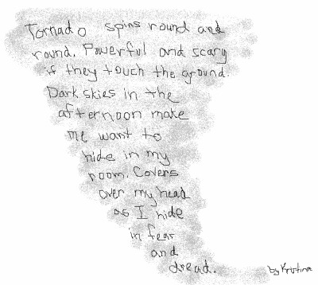
Concrete
Concrete (or shape) poetry is an inventive form where the poetry takes on the shape of its subject

Slide 8
Cinquain
Cinquain is a formal poem that follows certain rules.
The first line is one word, and it is the subject of the poem.
The second line is two words that describe the subject.
Line three is three words that describe and action of the subject
The fourth line is four words that describe a feeling about the subject
And the last line is one word, usually a synonym for the subject, or a word description, event, or feeling to sum it up.
Example:
Train
Swiftly flies
Over the bridge
It roars; I gasp
Wow!
-Kathleen Christopher Hardy Petersen

Slide 9
Free Verse
Free Verse is a form of poetry that does not use formal rhyming patterns or meter.
It may not even have a form.
But, it all fits together somehow, as a satisfying, poetic expression, when it is read and enjoyed.
Example:
“I have no name,
I am but two days old.”
What shall I call thee?
“I happy am,
Joy is my name.”
Sweet joy befall thee!
Pretty joy!
Sweet joy, but two days old
Sweet joy I call thee:
Thou dost smile,
I sing the while;
Sweet joy befall thee!
-William Blake

